Slide 1
Using Plants of Ethnobotanical Importance to Address California Life Science Standards Grade Level: K – 12
By Andreana L. Ososki and John D. DeMartini*
Redwood Science Project
August 2006
*Photos credits

Slide 2
Grocery Store Ethnobotany

Slide 3
Discussion: List any plants or plant products you have used in the last 24 hours.

Slide 4
What’s a fruit? What’s a vegetable?

Slide 5
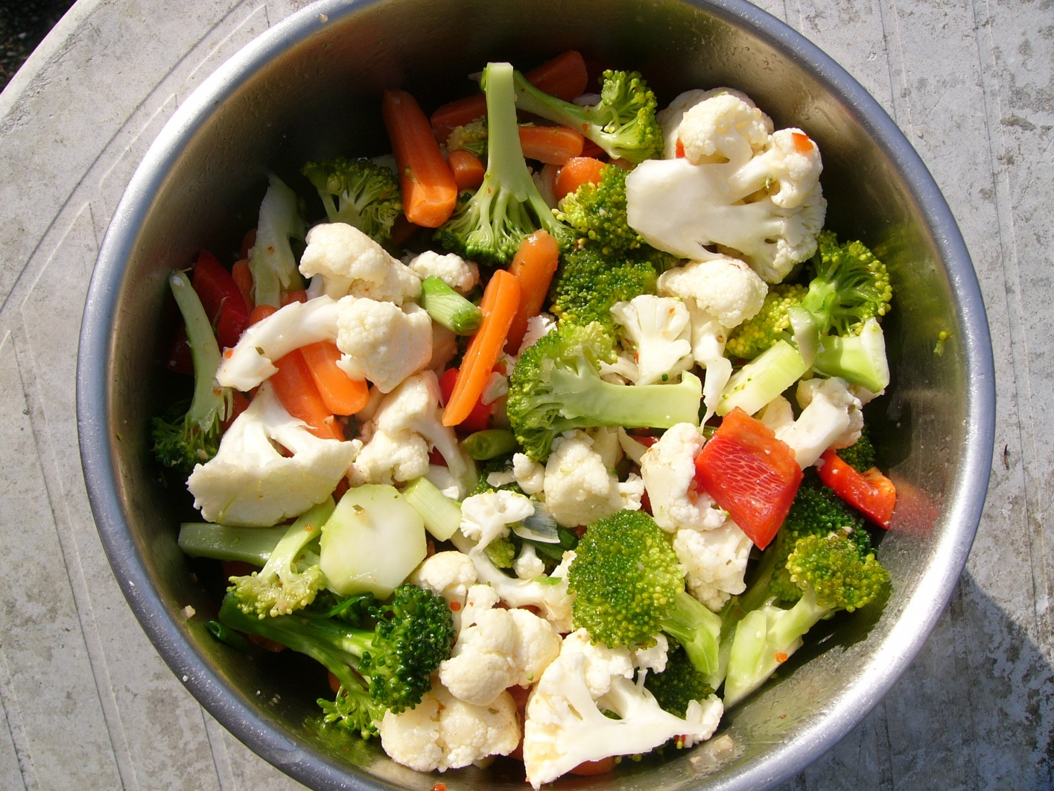
Vegetable Salad

Slide 6
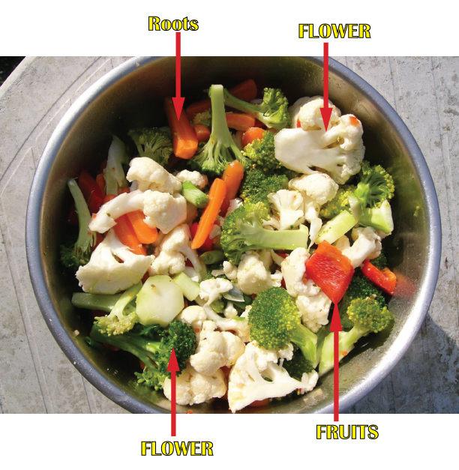

Slide 7
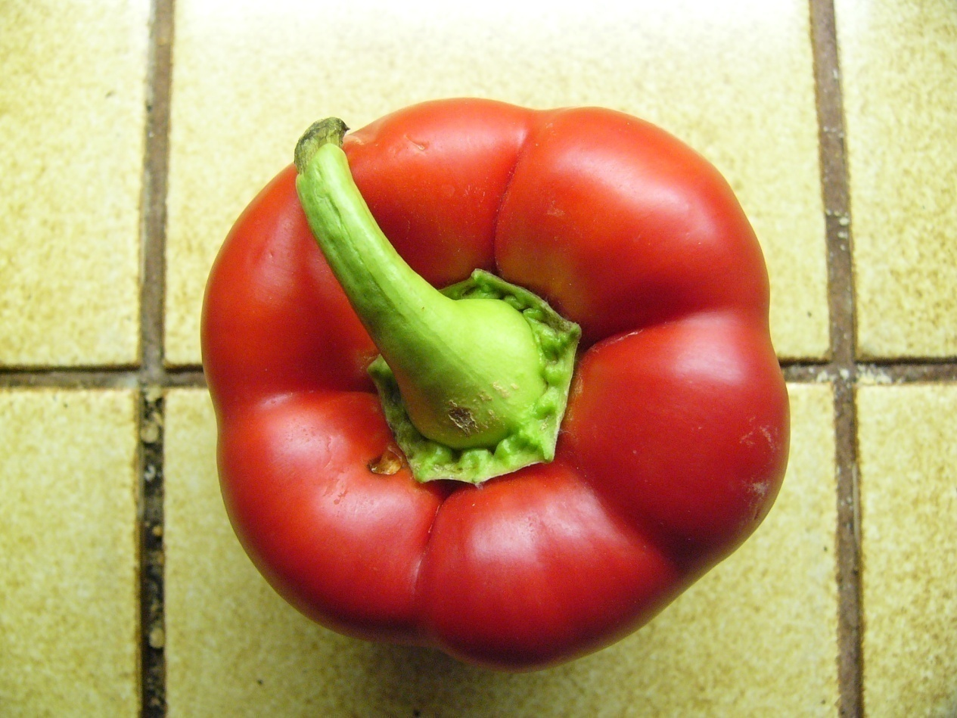
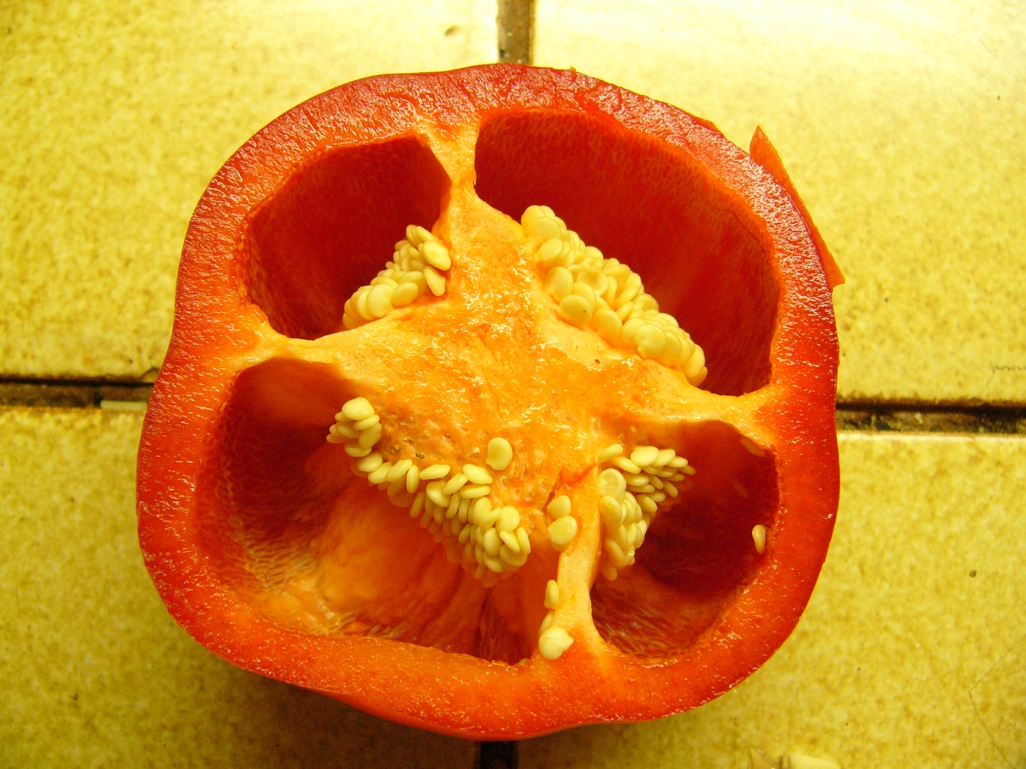
Bell pepper, Capsicum annuum
FRUIT

Slide 8
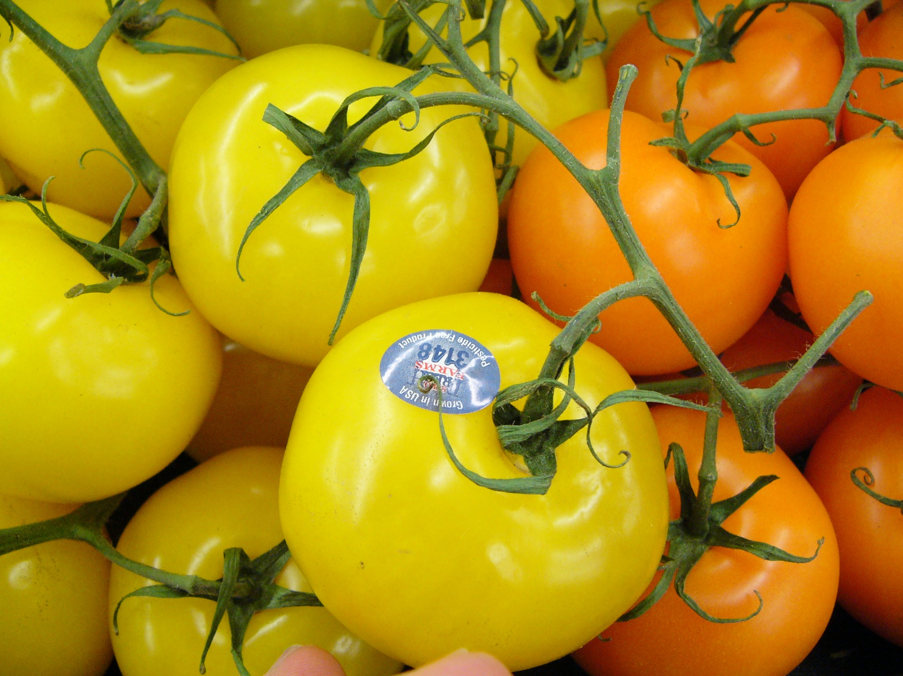
FRUIT
Lycopersicon esculentum

Slide 9
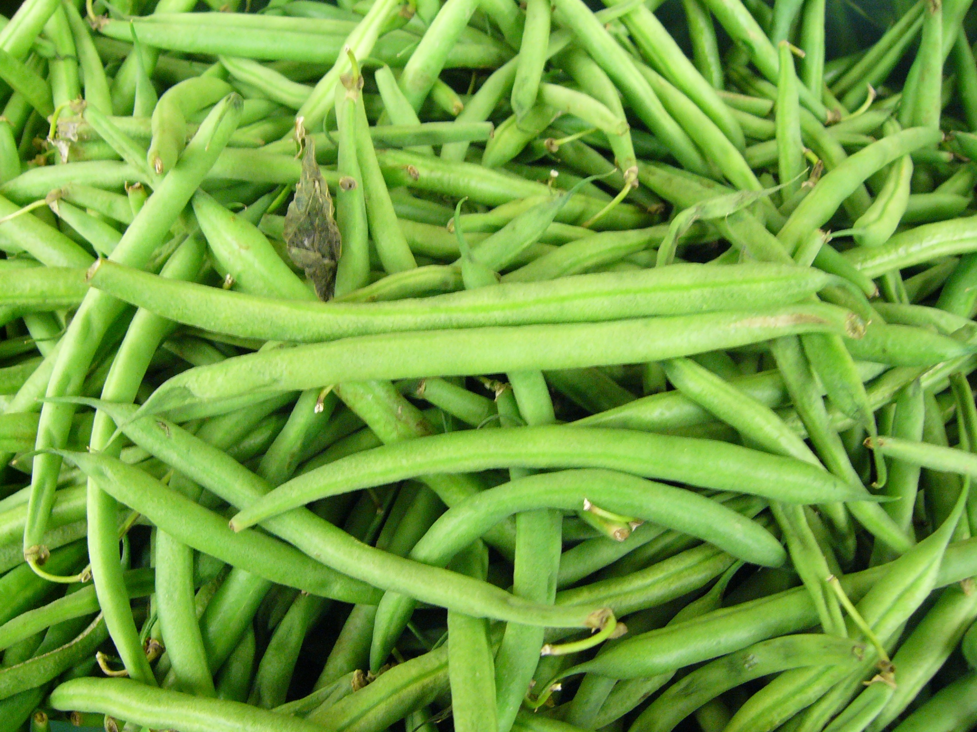
FRUIT
Phaseolus vulgaris

Slide 10
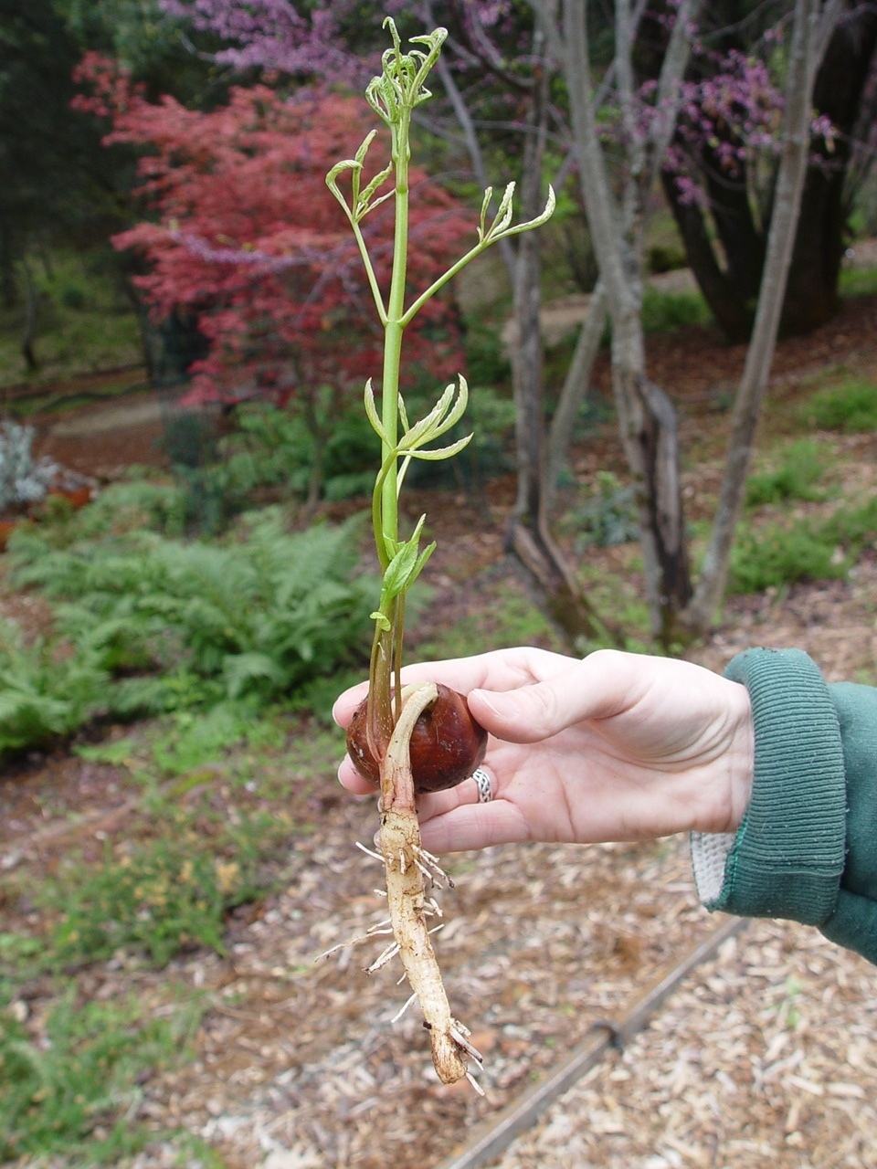
region of apical meristem of the shoot
leaf
node
shoot system
cotyledons with surrounding seed coat
root system
lateral root
Buckeye, Aesculus californicus
Photo credit: William Ososki

Slide 11
Now, on to plants and plant parts in the grocery store

Slide 12
What Are Examples of Edible Roots?

Slide 13
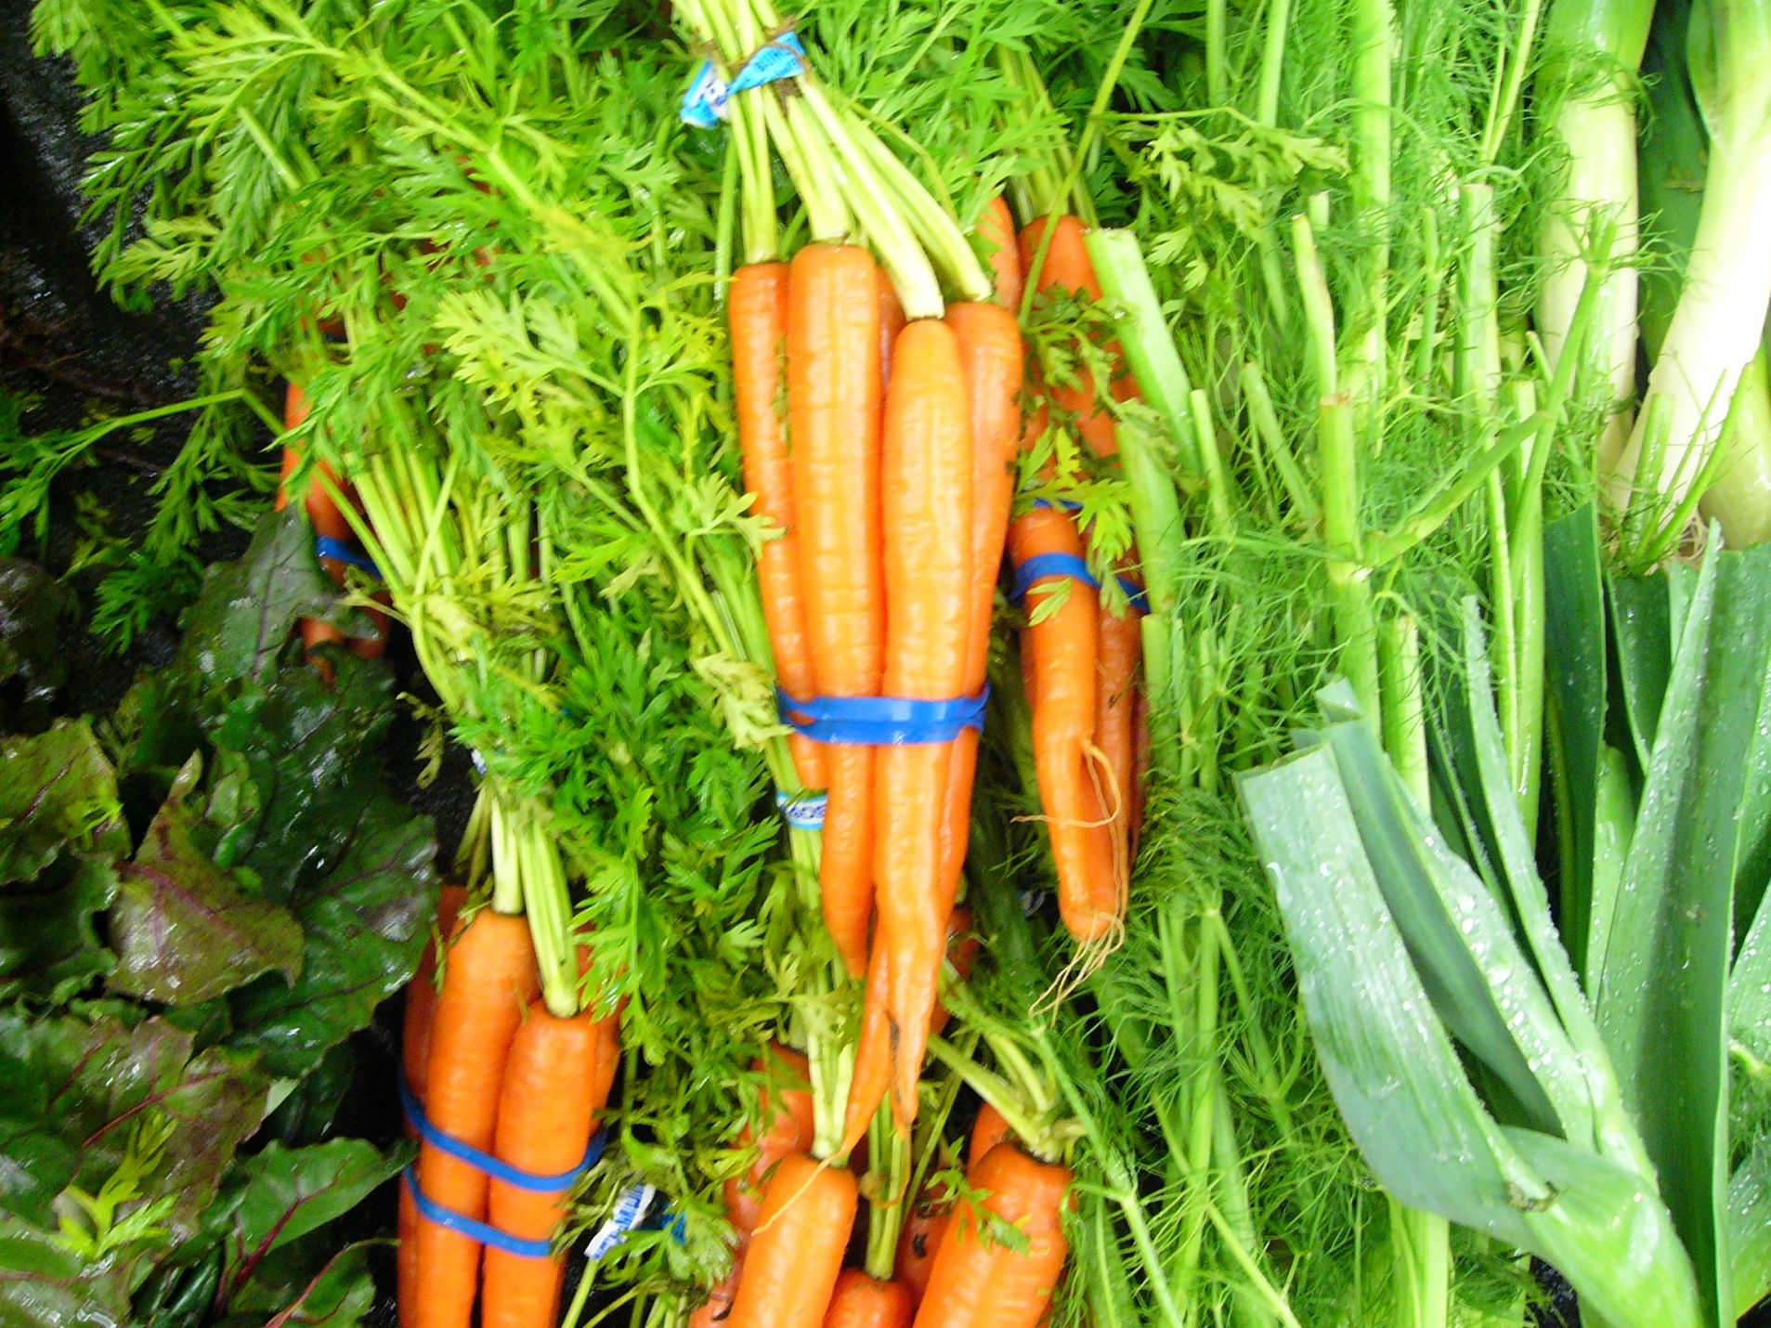
Roots
Carrot, Daucus carota

Slide 14
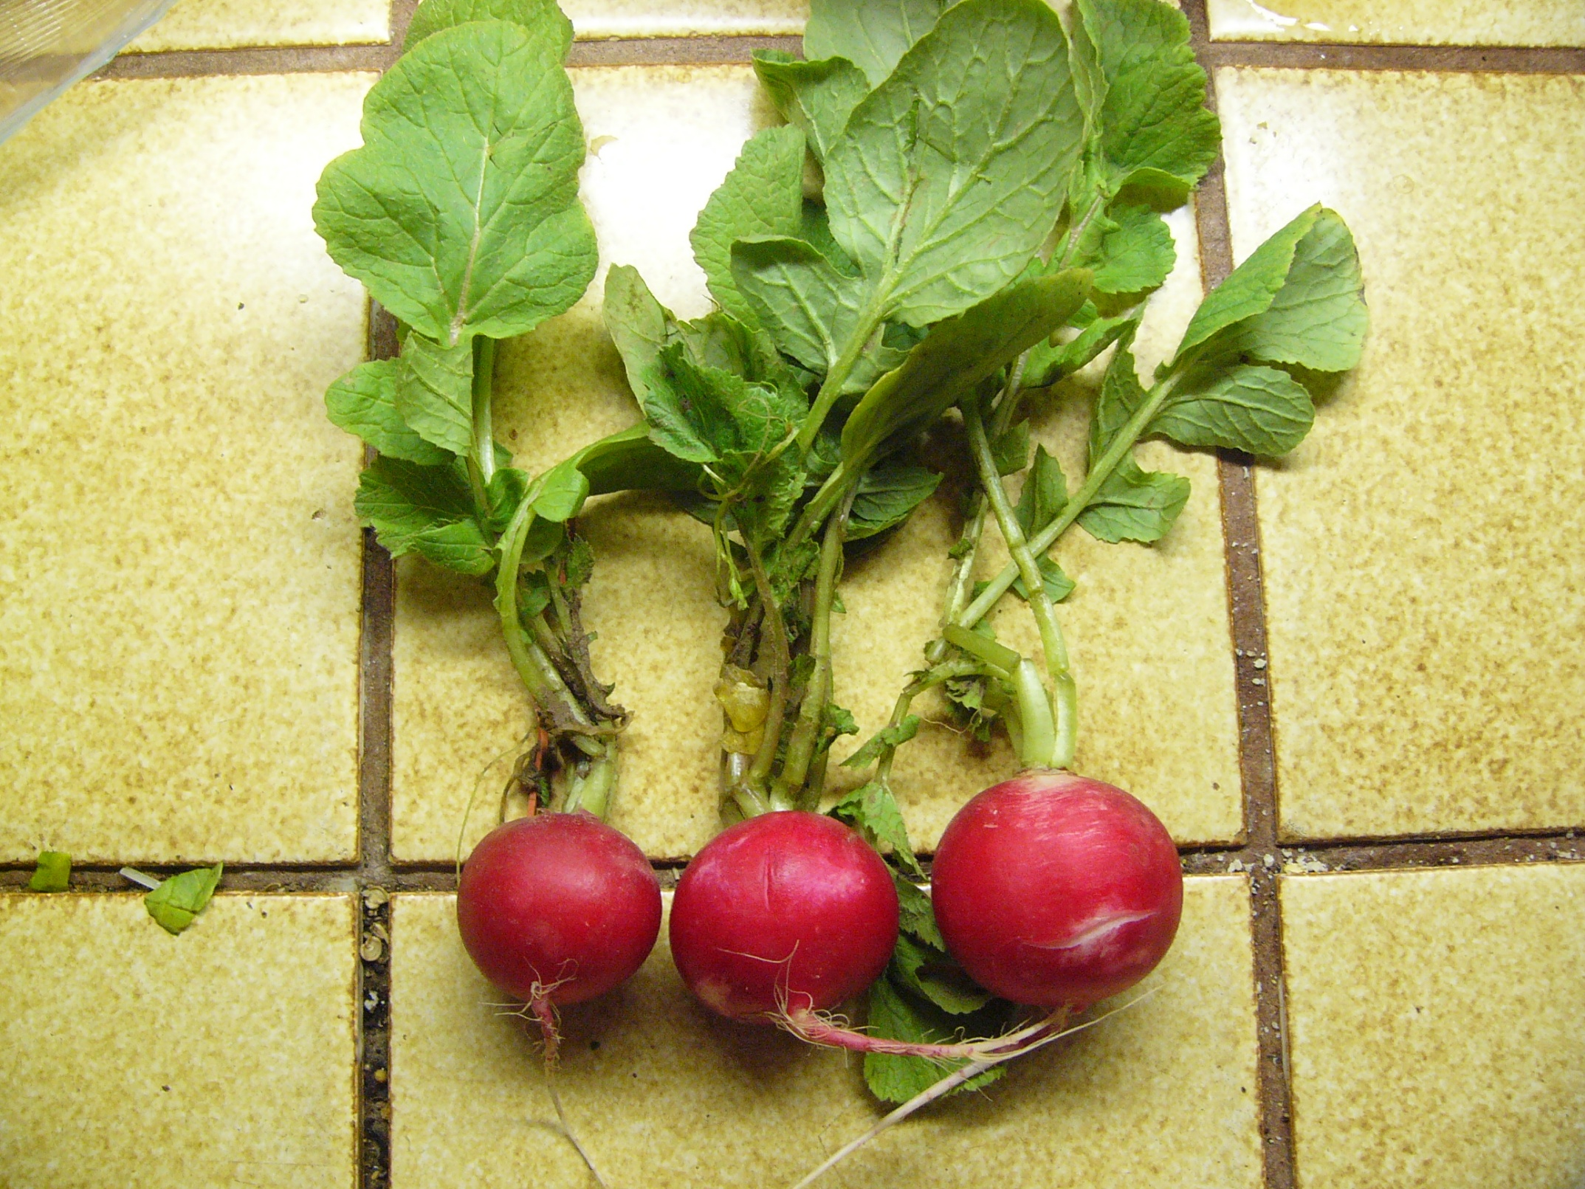
Radish, Raphanus sativus

Slide 15
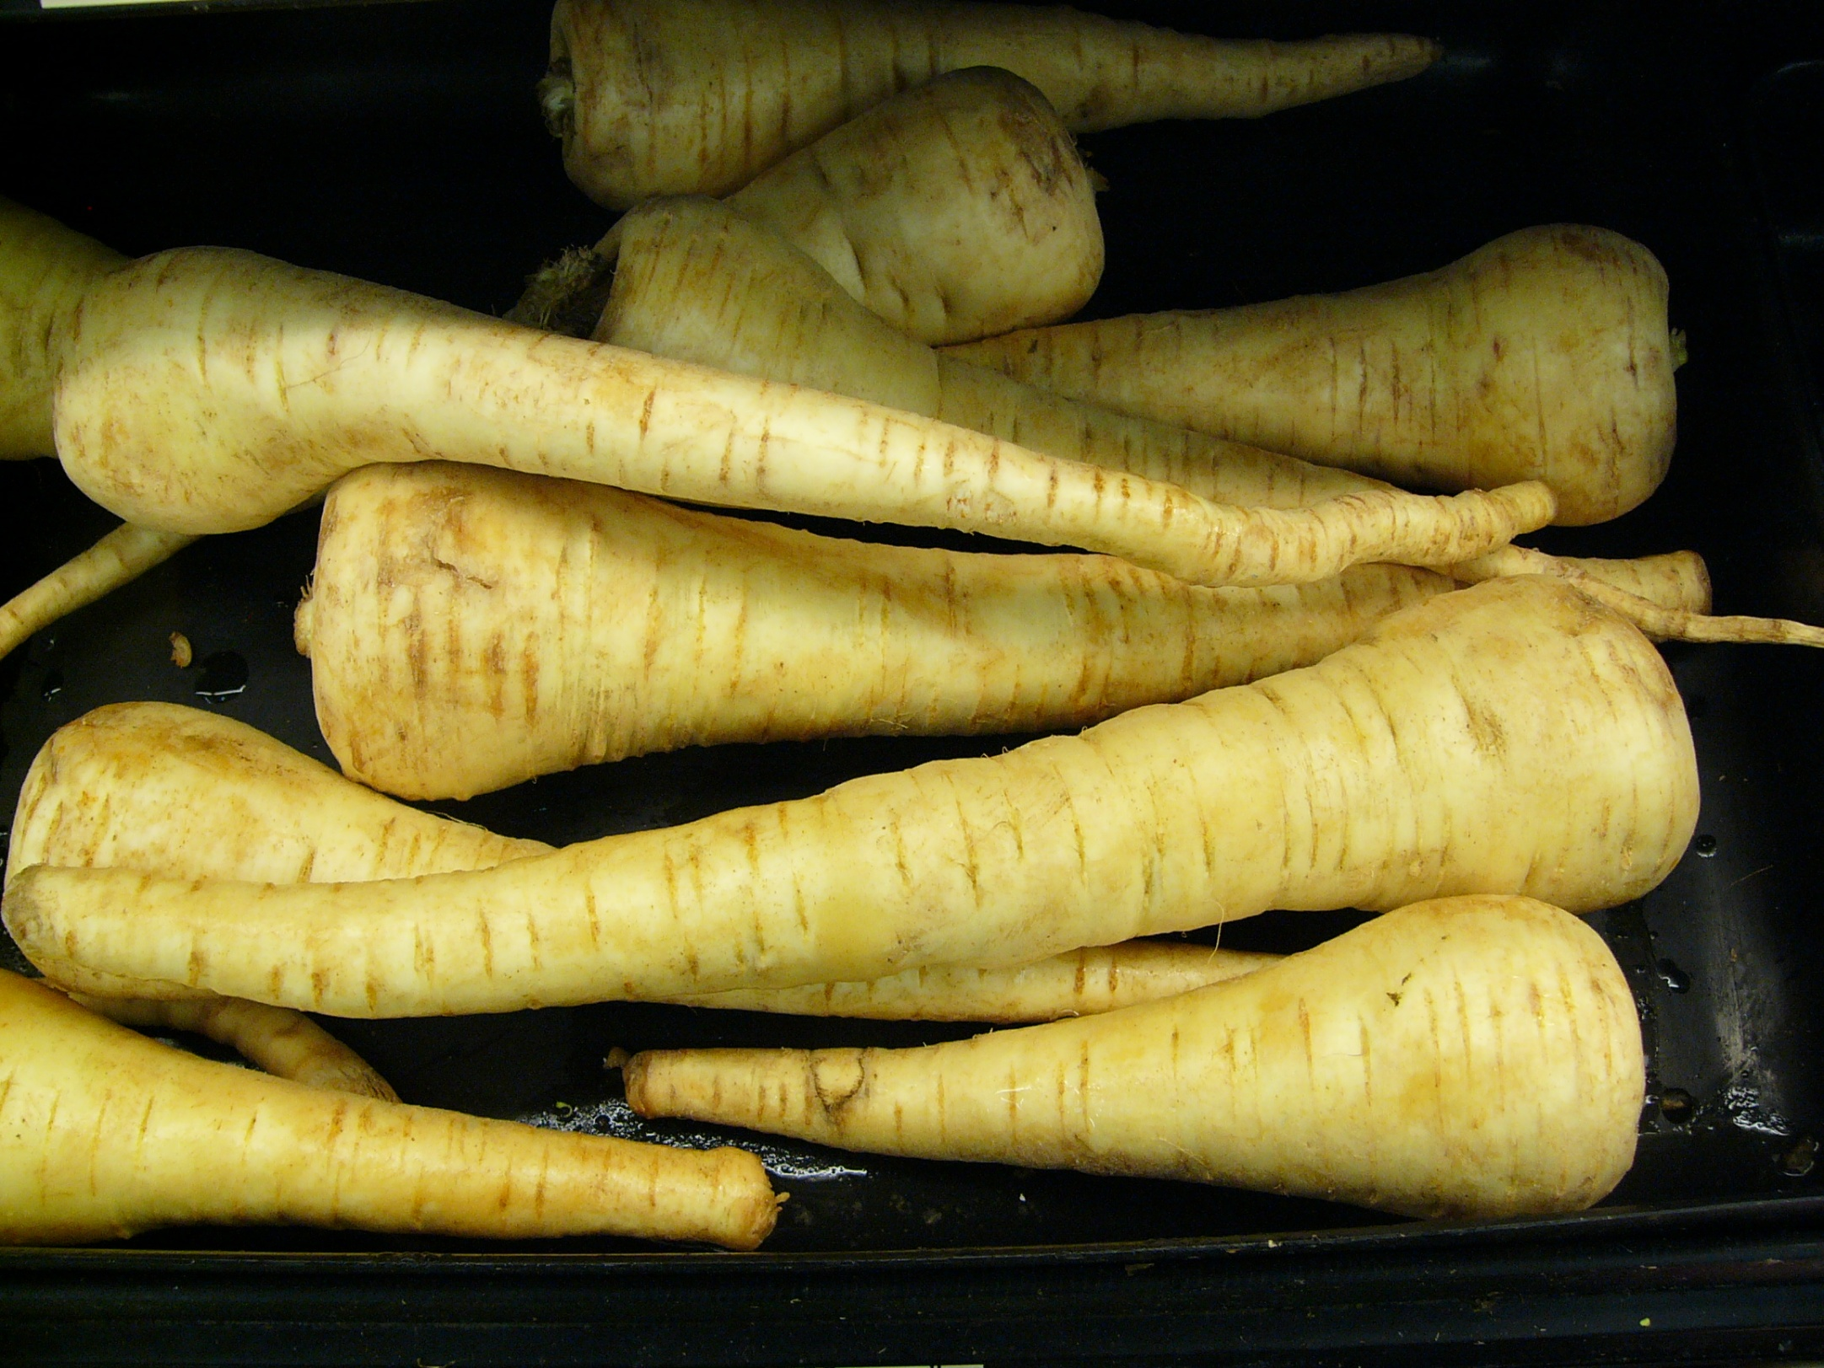
Parsnips, Pastinaca sativa

Slide 16
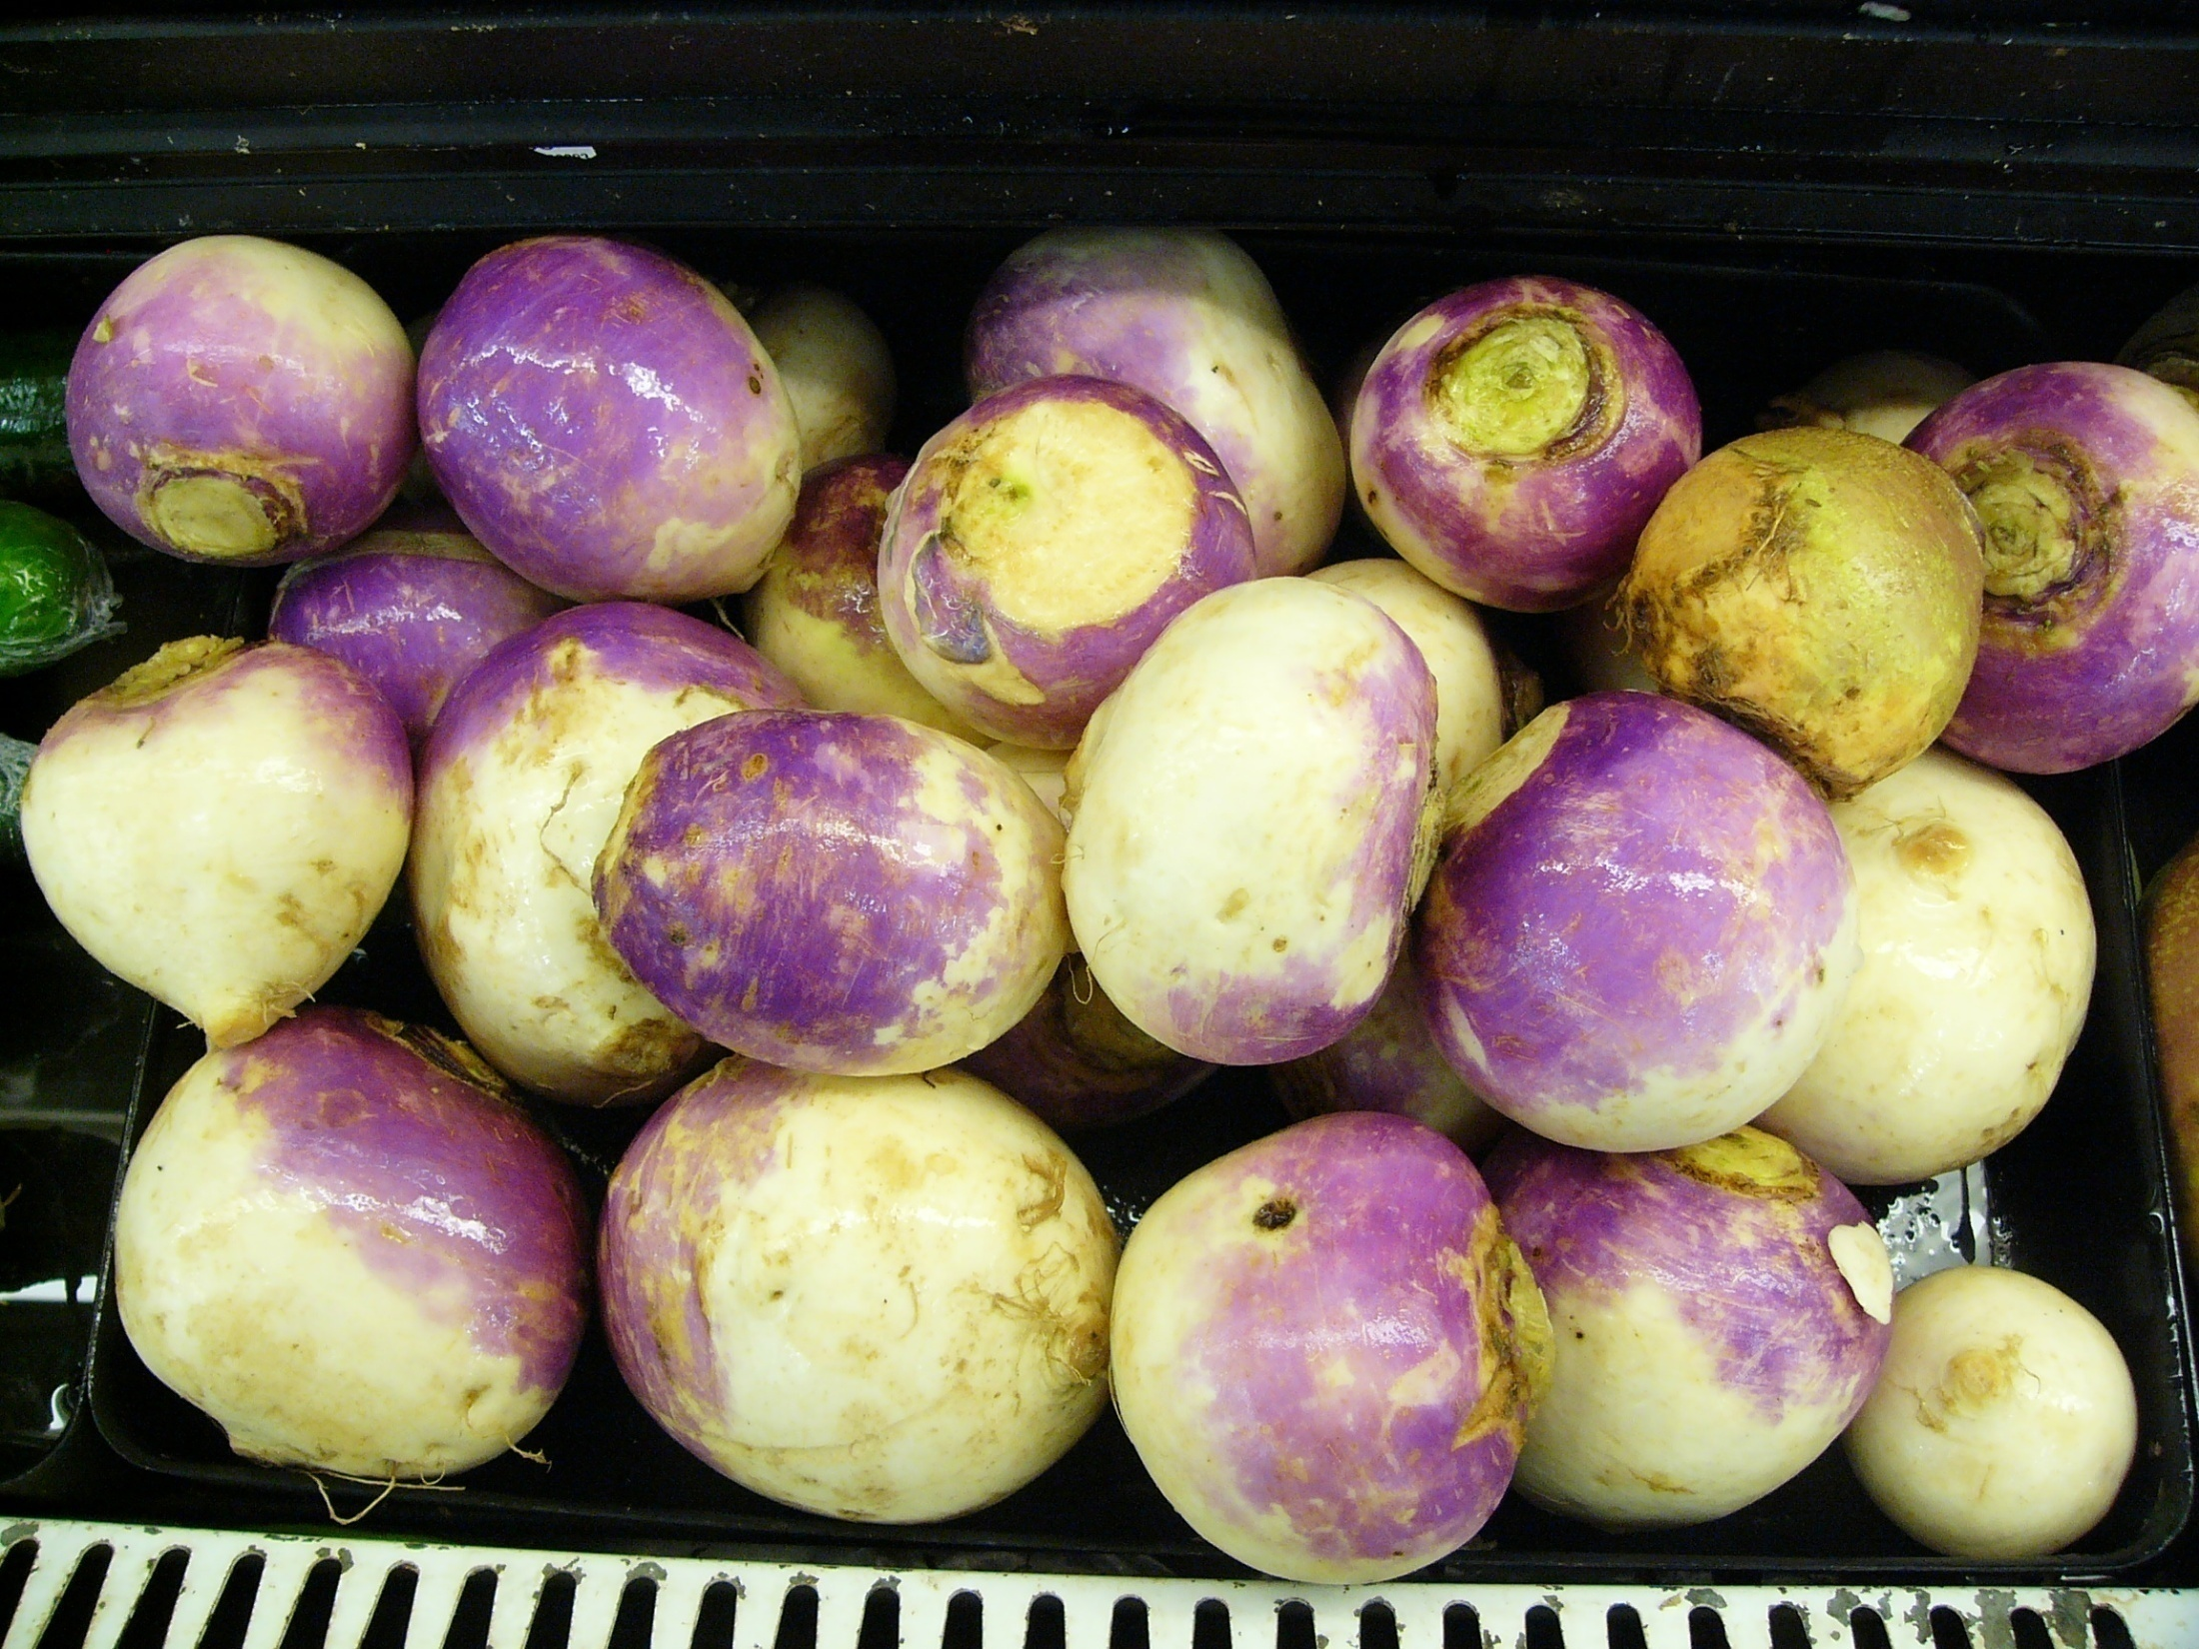
Turnip, Brassica rapa

Slide 17
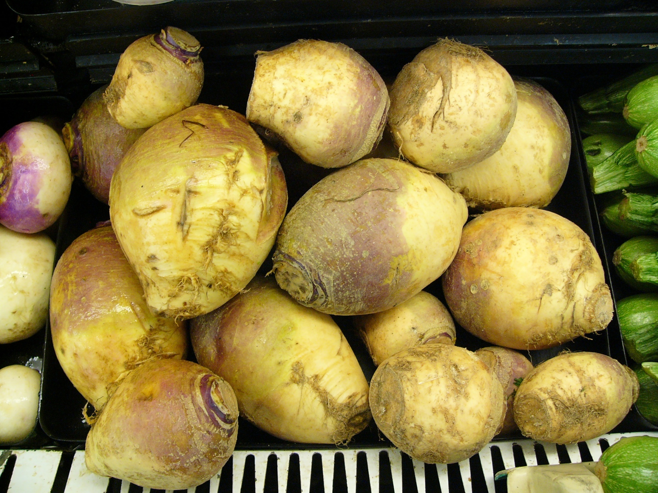
Rutabaga, Brassica napus

Slide 18
What are Examples of Edible Stems?

Slide 19
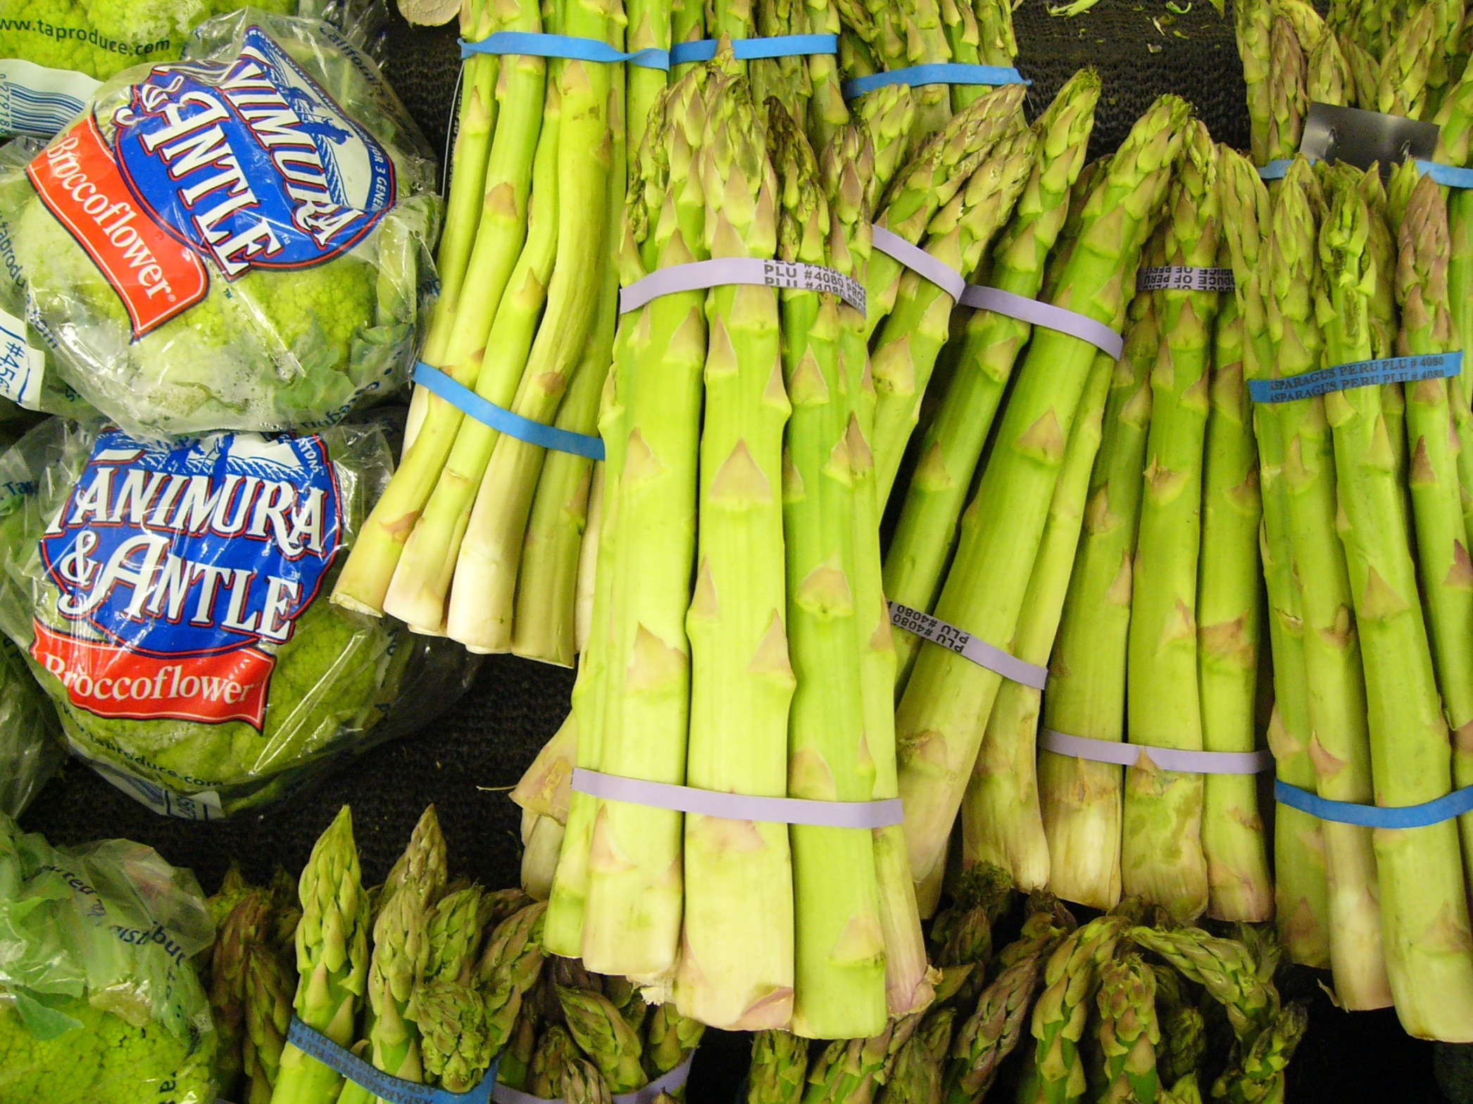
Asparagus, Asparagus officinalis

Slide 20
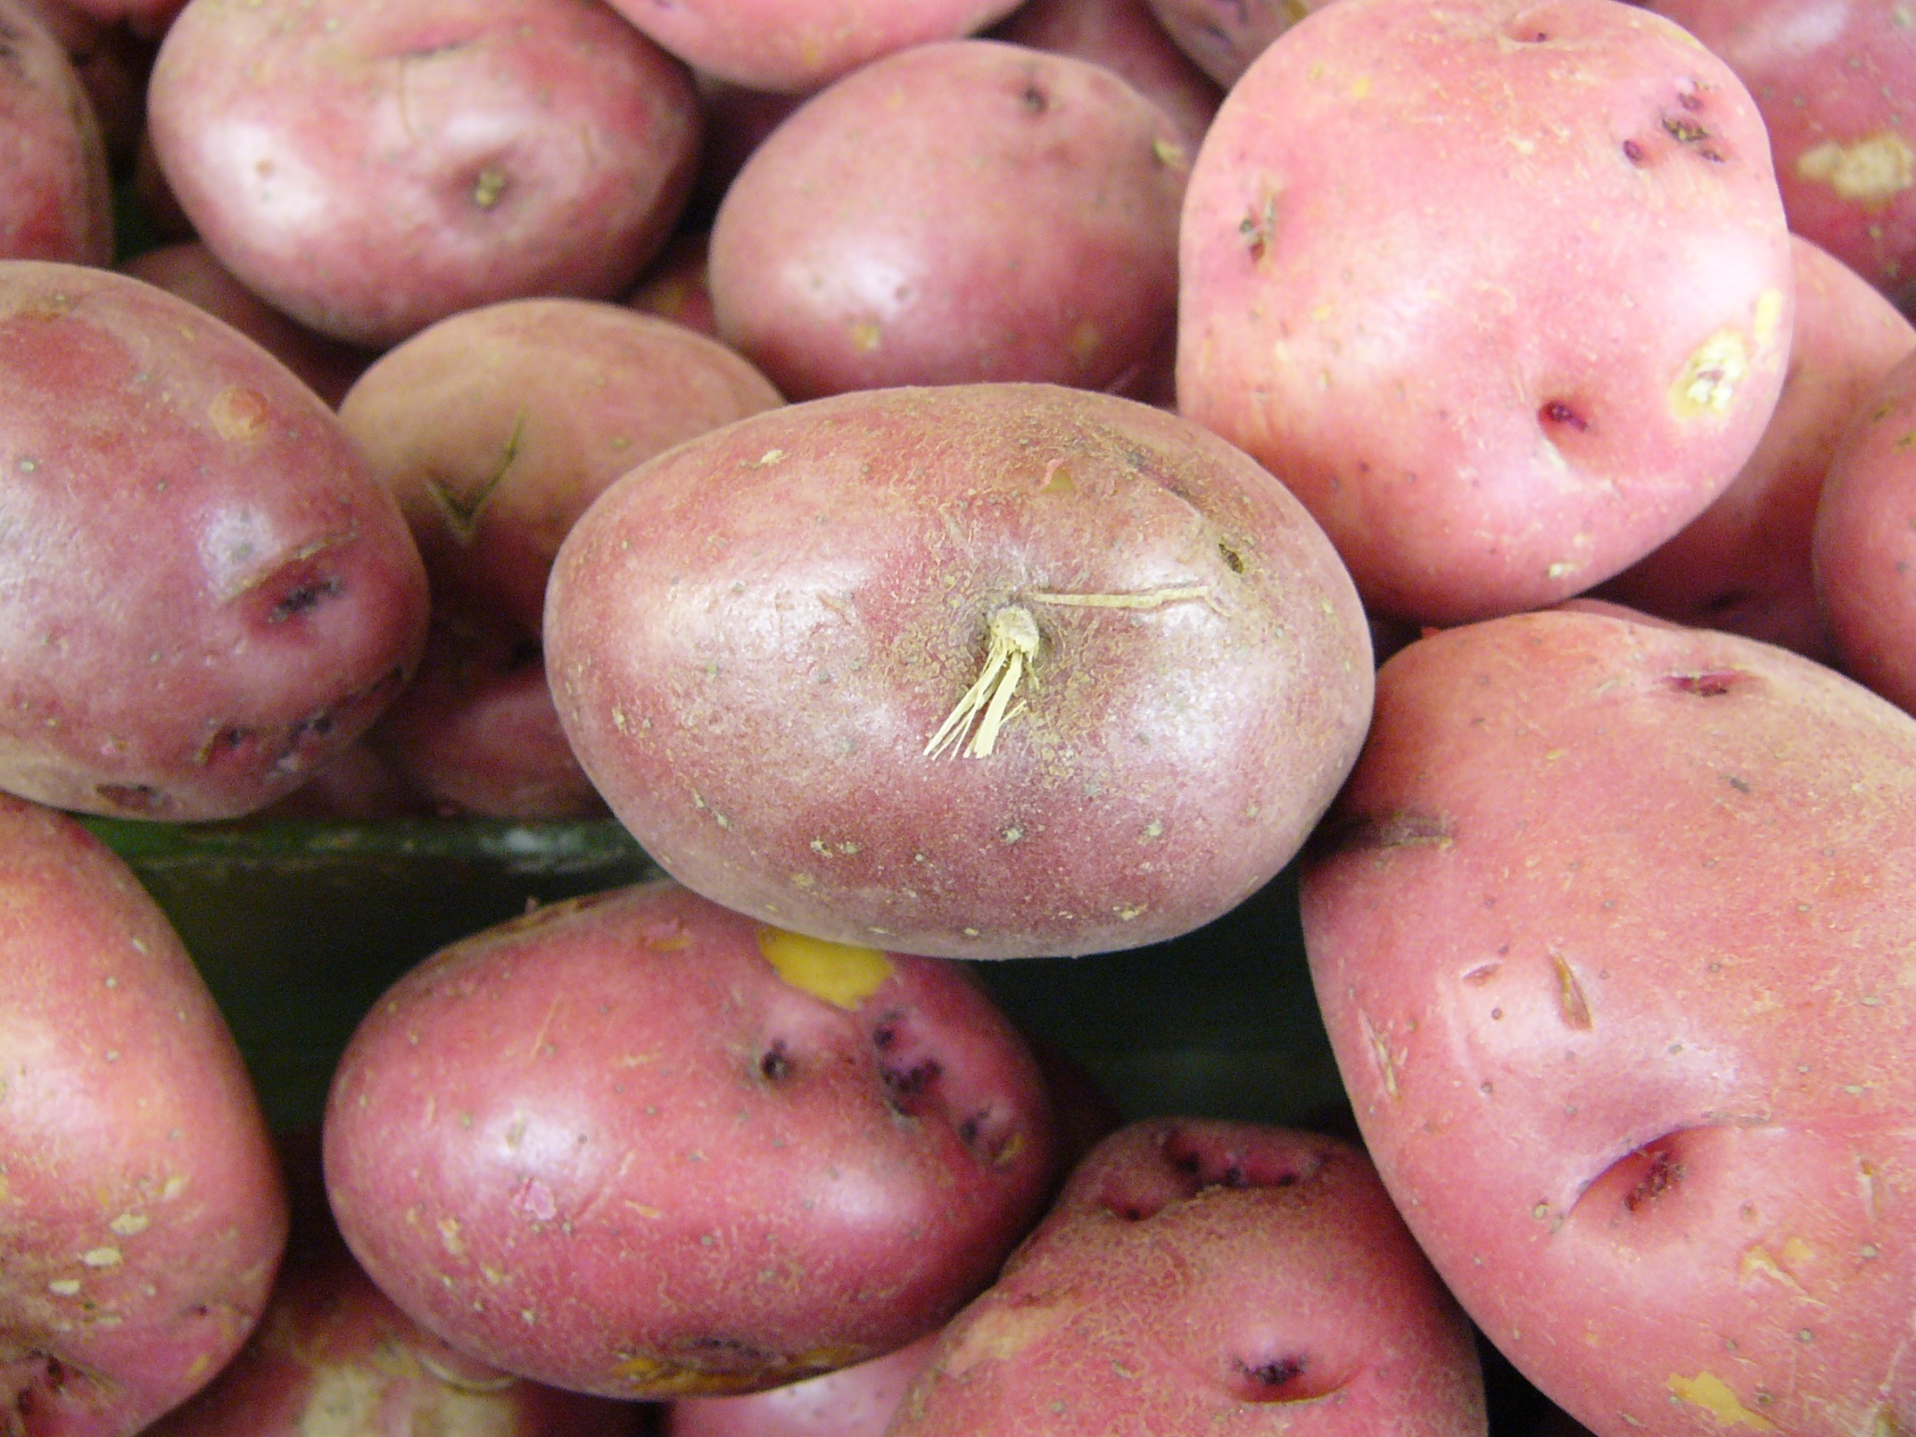
Potato, Solanum tuberosum
buds

Slide 21
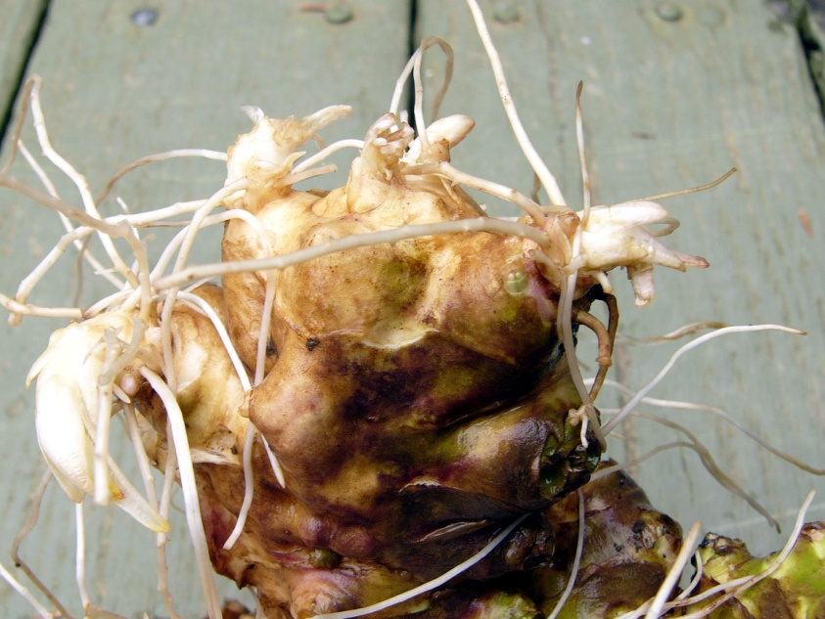
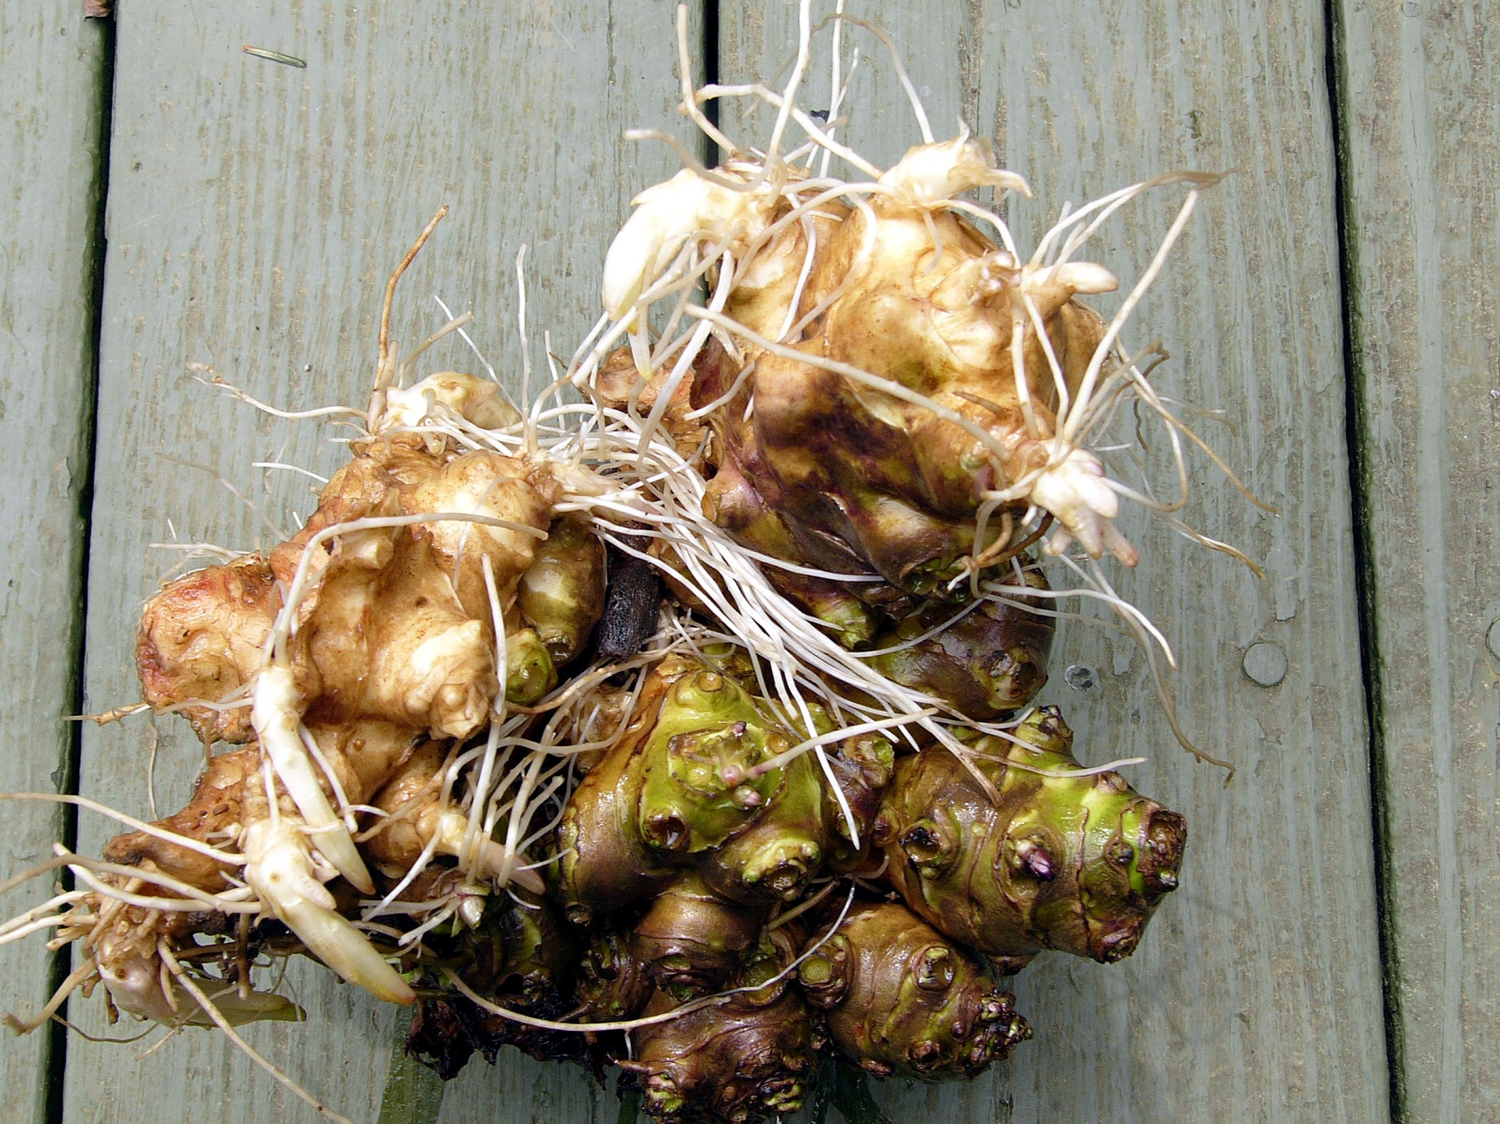
Jerusalem artichoke, Helianthus tuberosus
germinating shoots and roots
buds

Slide 22
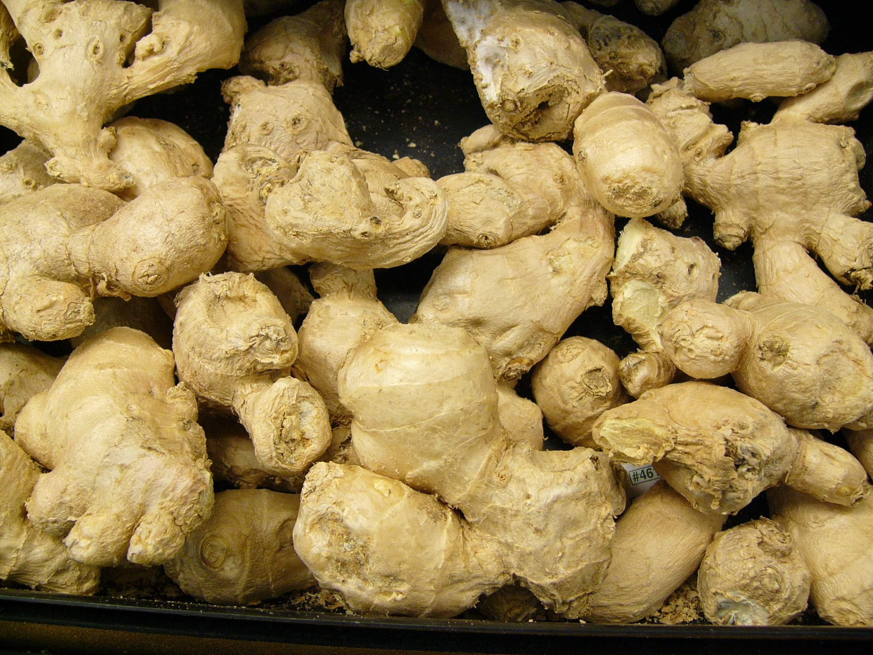
Ginger, Zingiber officinale

Slide 23
What are Examples of Buds that We Eat?

Slide 24
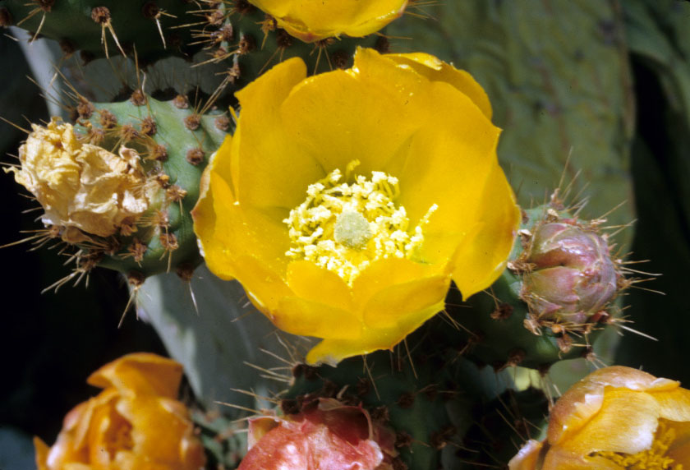
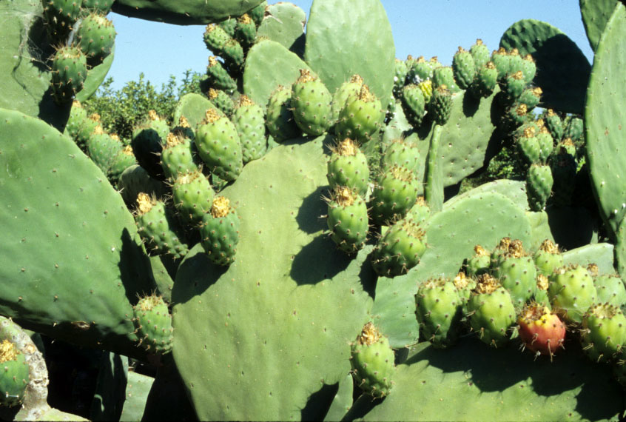
Indian fig or Prickly pear, Opuntia ficus indica

Slide 25
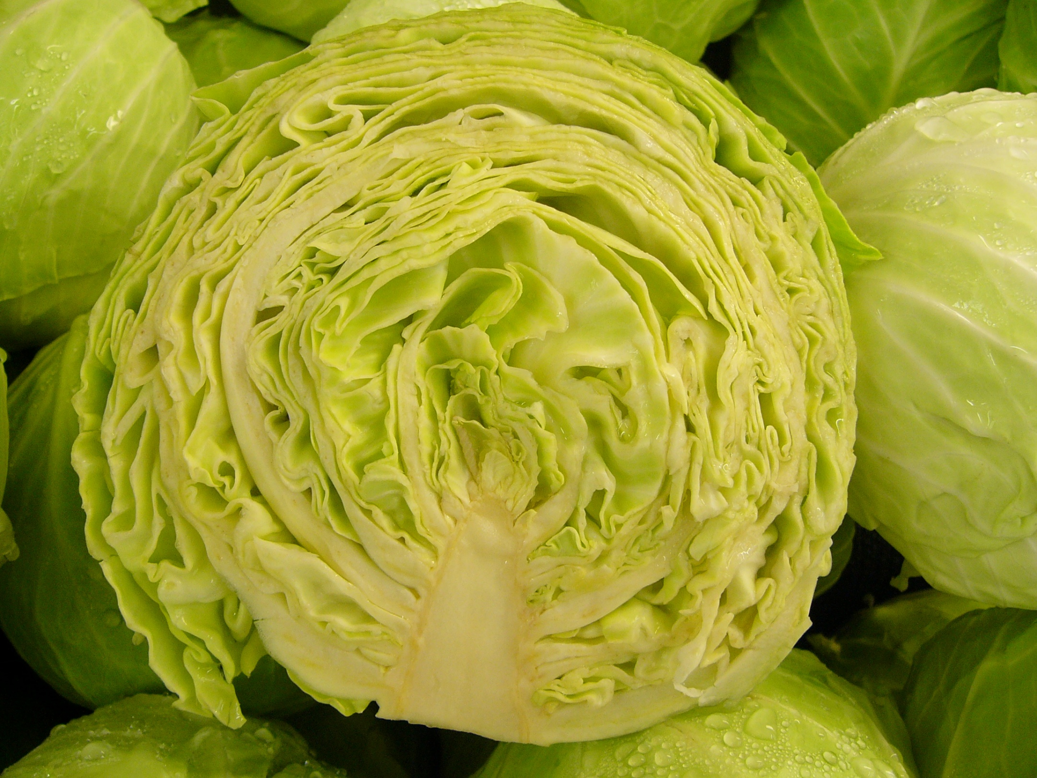
Cabbage, Brassica oleracea

Slide 26
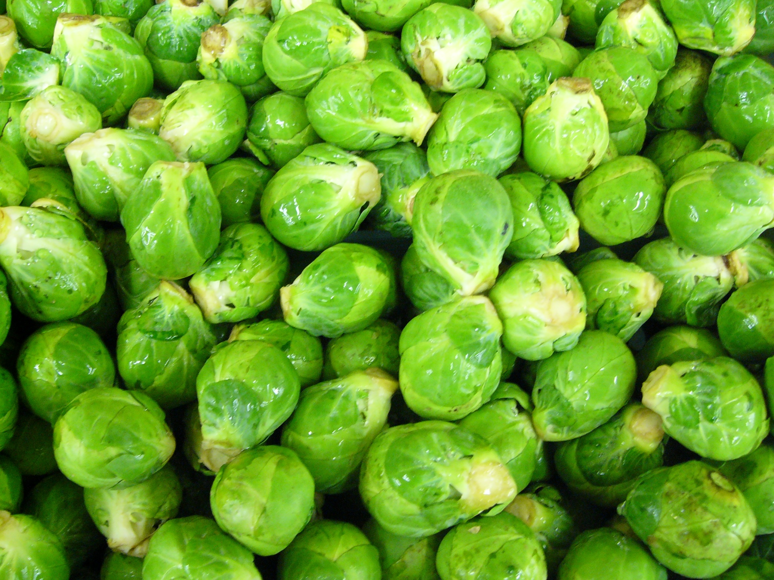
Brussels sprouts, Brassica oleracea

Slide 27
Flower Typology Let’s Look at Flowers

Slide 28
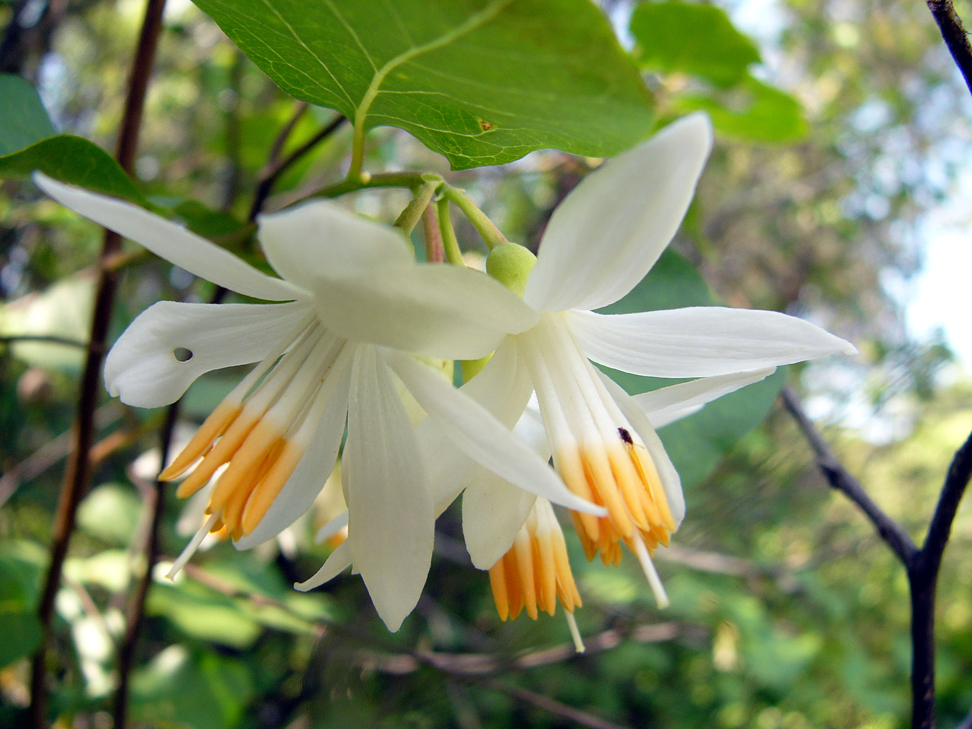
Snowdrop bush, Styrax officinalis

Slide 29
fused sepals
petal
filament
stamen
anther
style
stigma

Slide 30
Can You Think of Flowers that We Eat?

Slide 31
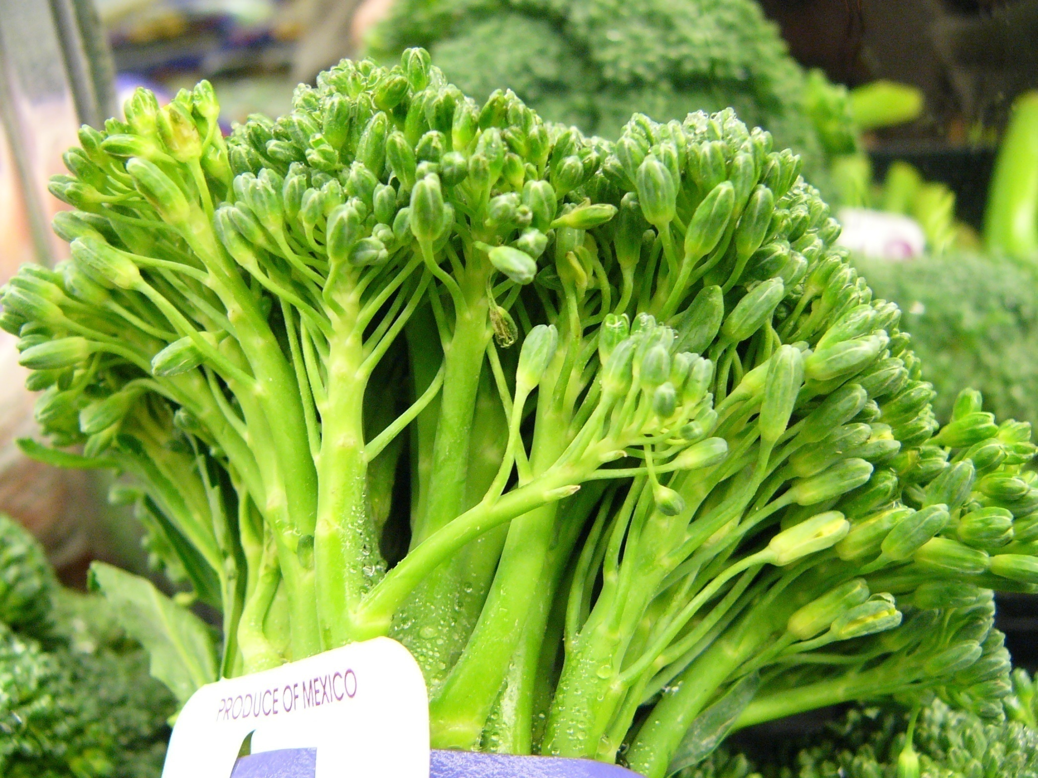
Broccoli, Brassica oleracea

Slide 32
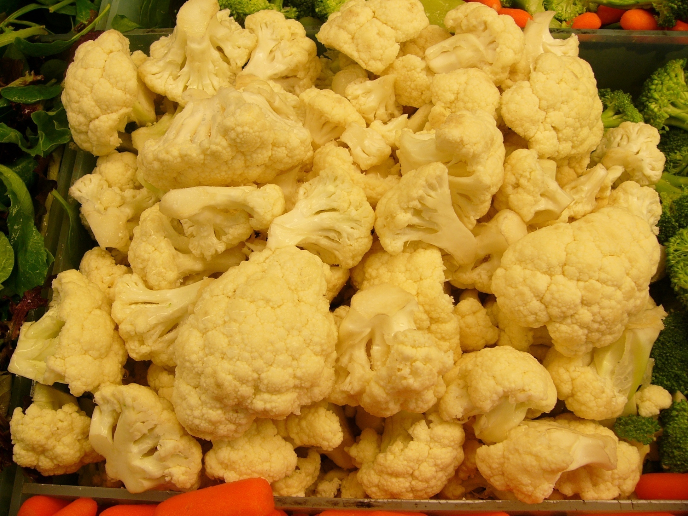
Cauliflower, Brassica oleracea

Slide 33
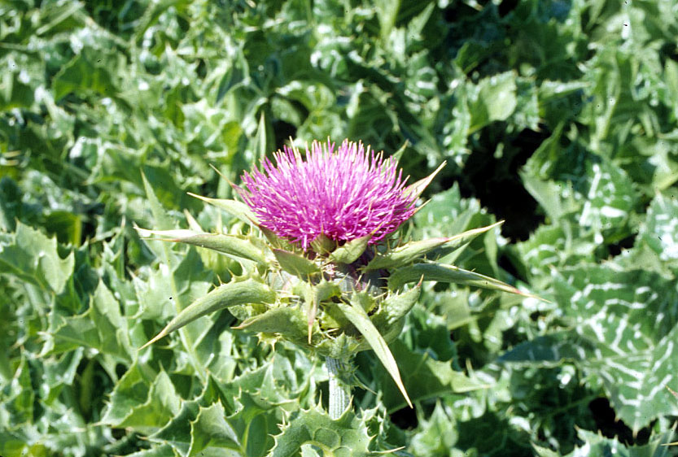
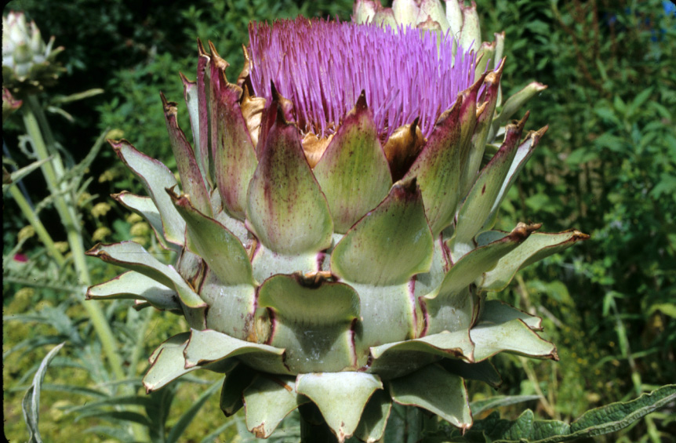
Sunflower Family - Asteraceae
Milk thistle, Silybum marianum
Artichoke, Cynara scolymus
disk flowers only
involucre (composed of bracts)
bract = phyllary

Slide 34
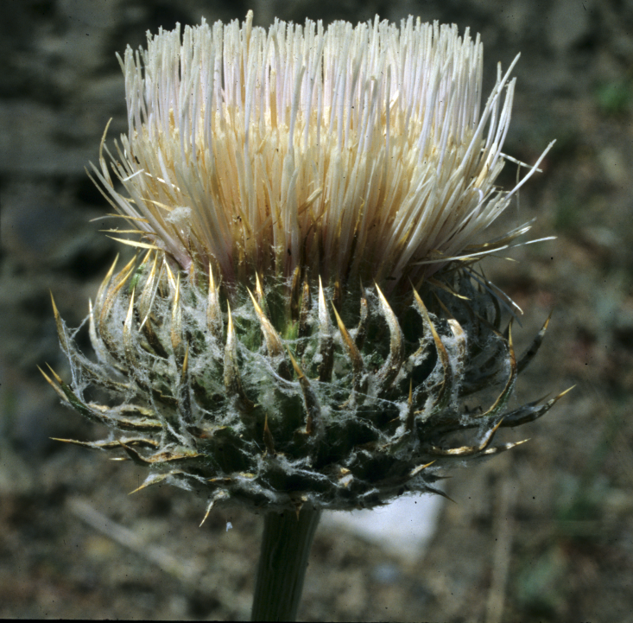

Sunflower Family - Asteraceae
Thistle, Cirsium sp.
Artichoke, Cynara scolymus
disk flowers only
involucre (composed of bracts)
bract = phyllary

Slide 35
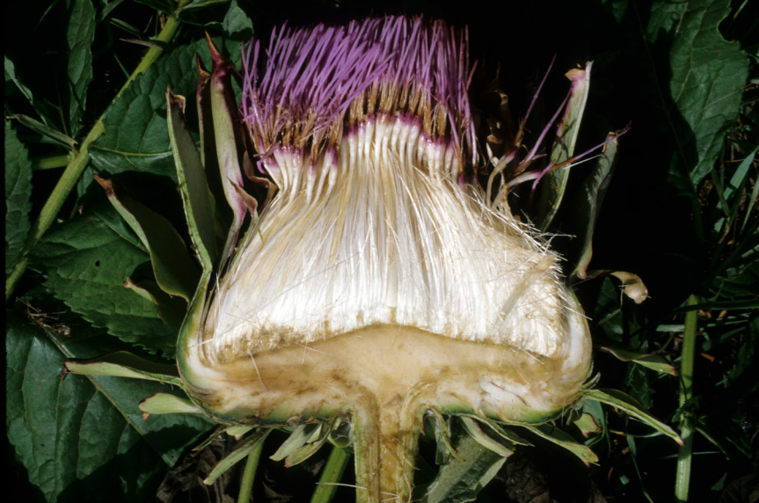
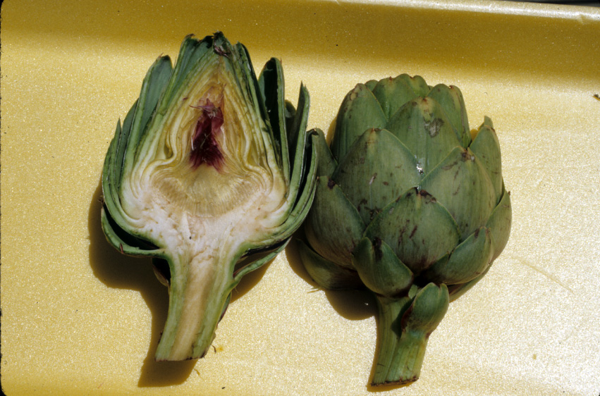
Artichoke, Cynara scolymus
immature disk flowers
mature disk flowers with white pappus (modified calyx)
bract = phyllary
receptacle (heart)

